Slide 2
Inductive Bible
Study Method

Slide 3
Welcome to IBSM
BS510 Inductive Bible Study Method

Slide 4
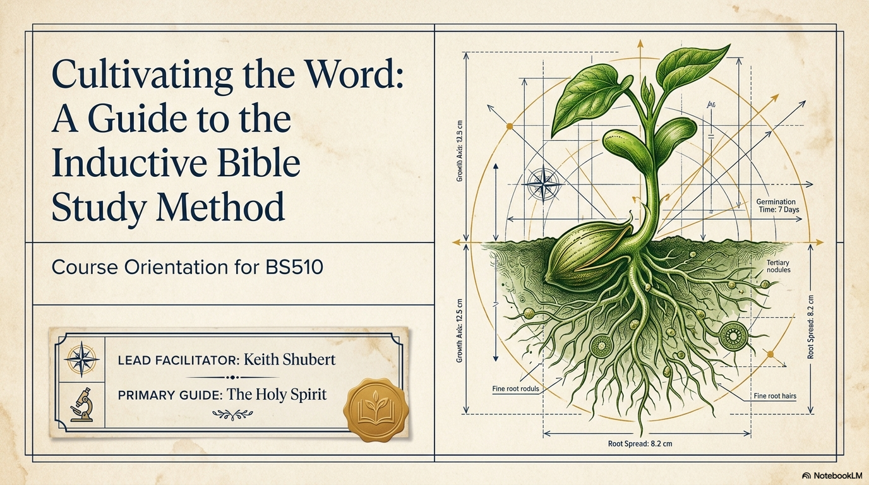

Slide 5


Slide 6
Session Objectives
Upon completion of today’s session, you will be able to:
Understand our hopes and expectations
Give some reasons people do not study the Bible on their own
Understand the different approaches to Bible study
Describe the danger of bad hermeneutics
Explain the need and benefits of systematic IBSM
Understand the need for systematic study of God’s Word.
Notes:
Origin of Scripture
Purpose of Scripture
Result of studying Scripture

Slide 7
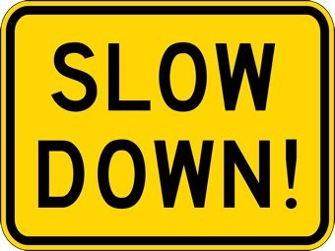
Our Hope
By the time you finish this course, you will…
  Read the Bible “slower” than before
Notes:
This world has gotten a lot faster, and I’m having a tough time keeping up.
There is a strong belief that faster is better.
Recently on FB, my friends have been sharing with secret recipes on how we can cook a nice dinner in 15 minutes or less.
People in general are getting more and more impatient. While I was in the US, many people used the “same day delivery” service in Amazon. Quite often, I’d find the message on Amazon, if you order this _____ now, you will get this computer delivered to you by 3pm today guaranteed.
Because of all these wonderful services, slowly but surely, we have become very impatient. And if we are not careful we can also get impatient with God’s Word. Many popular Christian sites now offer daily devotion service, where they will email you a daily devotion that can be completed in 2 minutes…so that you can ATTEND TO THE MORE IMPORTANT THINGS IN LIFE.
You know what, when it comes to studying God’s Word, there is not short-cut, nor should there be shortcuts.
My hope is by the time you’re done with this course, you will start to read God’s Word slowly, but more attentatively.

Slide 8

Our Hope
Have more questions about God’s Word than before
Notes:
When I graduated from seminary, I ask my professor, who is a very well respected scholarly, I said, “prof, I don’t feel ready to graduate, because I actually have more questions now than before I started seminary.”
He looks at me with a gentle smile on your face. Before, you were not ready. But now, you are ready. You have more questions now because you are thinking more deeply, and that’s a good thing. The truth is, Jacob, you will continue to have many questions about God’s word, and that’s why we are all students of the Bible.

Slide 9

Our Hope
Be “less rushed” in interpreting God’s Word than before
Notes:
I led bible studies at church for many years before I went to seminary. And in those days, I was very quick at giving my interpretation of a particular passage.
By looking back, I was quick at giving my interpretation because I actually never thought about it carefully. Quite often, I would just share the first thought that came to my mind. Or I would say so and so said this, so that must be the right answer.

Slide 10

Our Hope
See fresh meanings in familiar passages

Slide 11

Our Hope
Not master the Word, but to have the Word master you (Rom 12:2)
Notes:
As you study God’s Word, I hope you end goal is not to master the Word (which by the way is impossible), but rather to have the Word master you.
Rom 12:2 says we are to be transformed by the renewing of our mind.

Slide 12
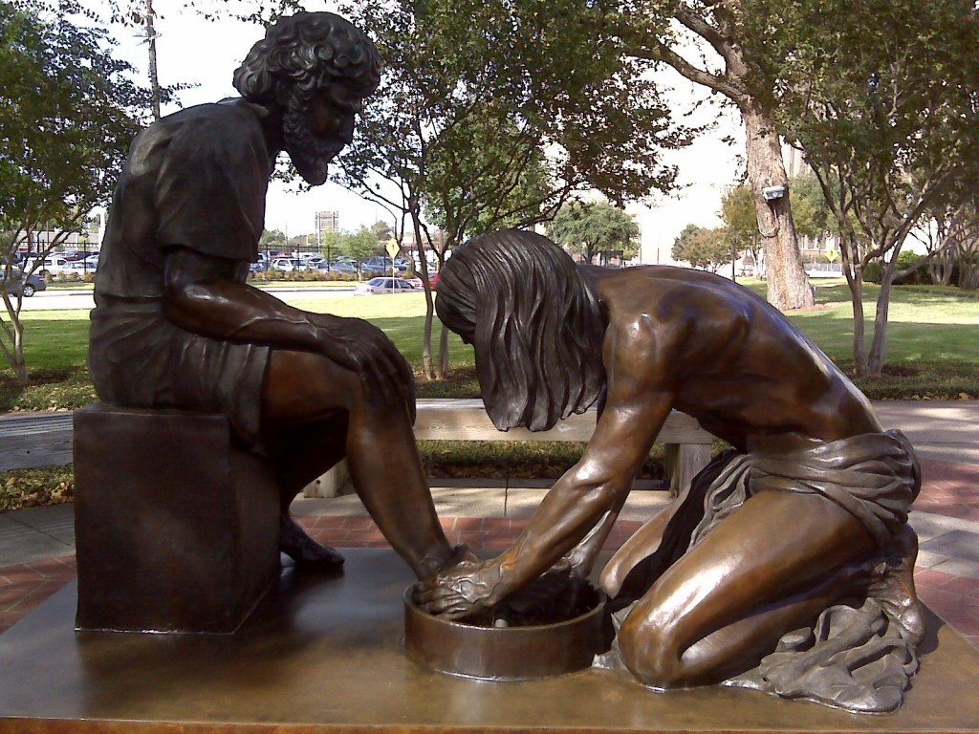
Our Hope
Ultimately be more Christ-like – esp. confidence in handling God’s Word and show humility in living it out
Notes:
For some of you, especially those how have never taken a course like this, or have written or led bible studies, you will need more confidence. I was like you when I went through seminary. Many of my colleagues came from Bible colleges, and some even knew Greek already. As for me, I studied “business” which many would argue is as “unspiritual” as it gets.
For others, especially if you have taken a course like this, or have led bible studies, I hope you’ll demonstrate humility in living it out. By the time you’re done here, and by the time you graduate from EAST, you’ll hopefully know more about the average believers. And that’s an exciting thing. However, my encouragement to you is as you grow in bible/theological knowledge, you will also grow in humility. 1 Cor 8:1 “…but knowledge puffs up while love builds up. “

Slide 13
Different Approaches to Bible Study
(Ref: The New Joy of Discovery in Bible Study, Oletta Wald)
Hit-and-miss approach
Application approach
Commentary approach
“Holy Spirit” approach
Systematic / Methodical / Inductive approach
Notes:
Hit & Miss – you bounce around in the passage, not quite sure what you’re looking for, but nevertheless, pick up some gems here and there, from time to time.
Application approach – most common, read the passage quickly, come up with a principle of two, then spend more of you time thinking of ways to apply the principles
Commentary approach – go to the commentary as your first stop, and let the commentary be your teacher … HERE’s a WARNING for you all: Ready for it. NO COMMENTARY IS INSPIRED.
“Holy Spirit” – spend most of your time in prayer and meditation. Read the passage, then look to the Holy Spirit to somehow miraculously reveal to you fresh insights and truths, without doing any serious study on your own. I have hear messages preached by individuals who claim to have received fresh insight on a particular passage…but when I look at the passage, what this guys says has nothing to do with it. I was scratching my head. Where in the world did he get this interpretation or insight from? The text does not say that, even if I read the text backwards, or upside down, I still can’t see what he’s seeing.
“Methodical Approach” – follow an orderly and logical pattern to study the Bible. This approach does not discount the importance of the other approaches, but rather incorporates them as appropriate.
Which approach is most common in “your world”?

Slide 14
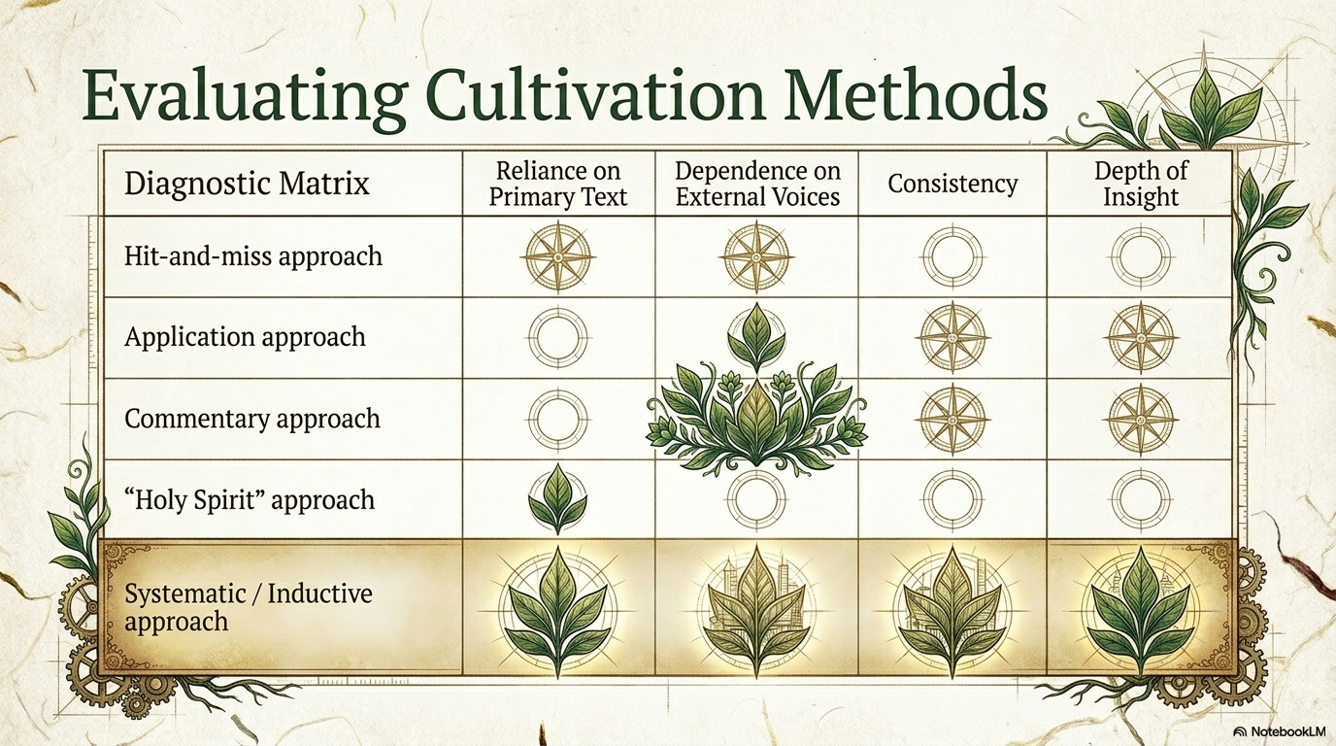

Slide 15


Our Approach
Notes:
The techniques and methods we teach you may seem rigid and mechanical at first. But trust me, they will help you.
My hope is you’ll practice the techniques and methods so frequently and repeatedly such that they become second nature to you. Once you do, you will begin to discover and read the Bible like never before!
Also, you learn more by doing than hearing what we tell you. It’s a bit like playing tennis. You don’t learn by listening to the coach, you learn by trying out what your coach tells you.
Hence, thank of us more as your coach, who will introduce you to a bunch of exercises that we believe will help you in your bible study.
My job is not to lecture, but to facilitate learning. You’ll have lots of time during and outside of class to practice and improve your skills
The skills you learn build on each other…so don’t think after you’ve completed an exercise or assignment, you can just put that skill away. NO.
You may also see repetition throughout this course. That’s intentional. Our hope is through repetition, you’ll perfect you skills.

Slide 16
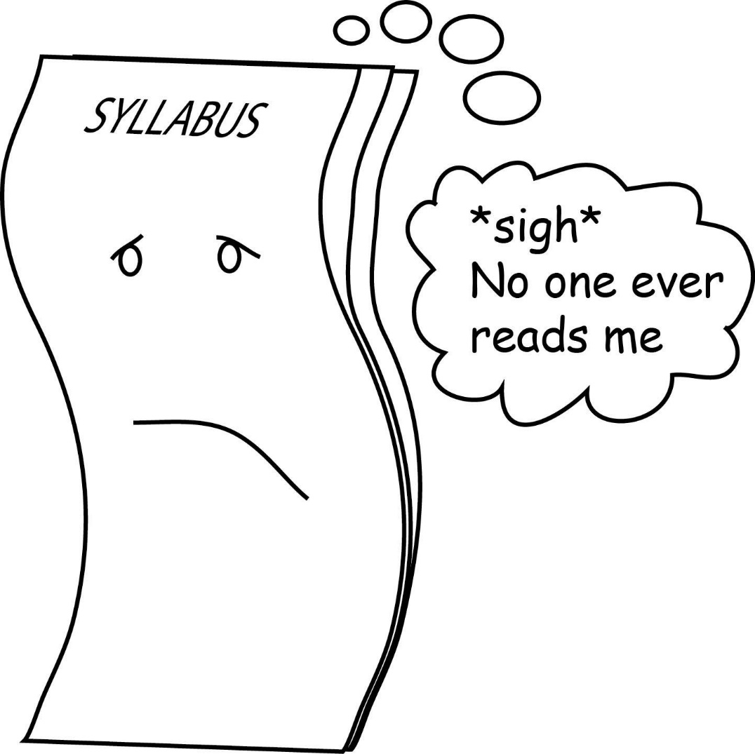
Our Plan
Let’s make sure we understand the syllabus

Slide 17
Two basic objectives
1. Understand this course
2. Understand need for
systematic Bible study

Slide 18
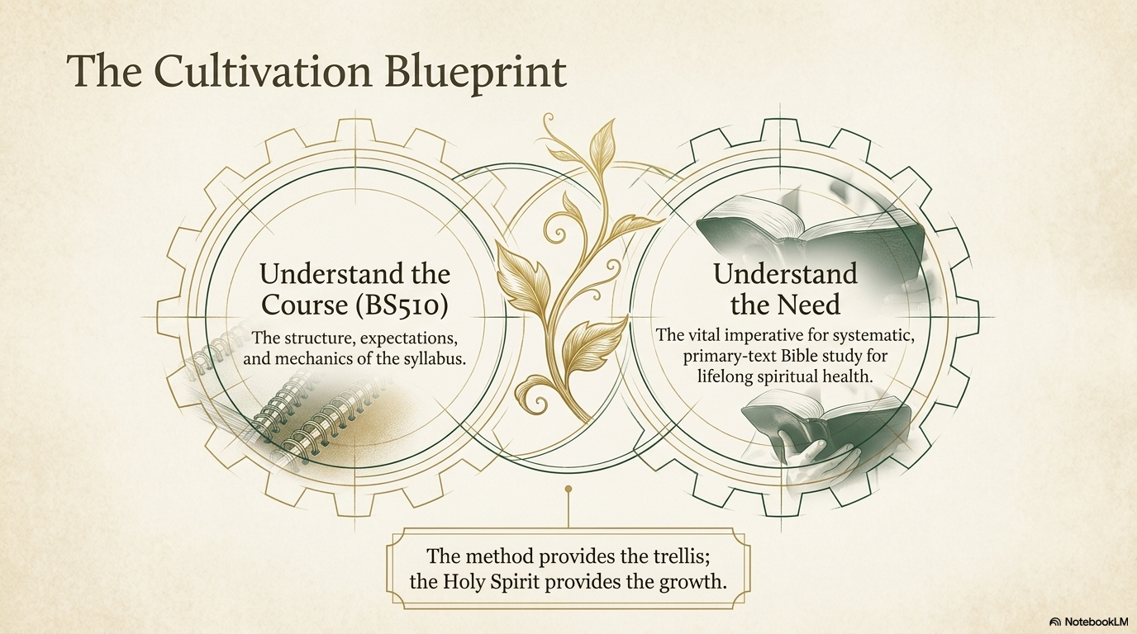

Slide 19
THE
SYLLABUS

Slide 20

CLASS
NOTES

Slide 21

Two Basic Questions
#1
#2

Slide 22
Why people don’t study Bible on their own?
They do not place it on their priority list.
They believe it is not relevant for today.
They do not know how to begin to study it.
They do not think they can understand it on their own.
Notes:
With your partner, try to come up with 3 tops reasons why people don’t study the bible on their own.
How many of you study the bible on your own? I don’t mean listening to sermons or listening to others about the Word through Bible Study. I mean study it regularly
on your own.
How many of you belong to churches or groups where majority of the people do bible study on their own regularly?

Slide 23
Two Basic Questions
#1
#2

Slide 24
Why do we need to study the Bible?
It is the only means for spiritual growth.
It is the divine means to develop spirituality.
It is the only means for preparation for ministry and life.
Notes:
With your partner, try to come up with 3 tops reasons why people don’t study the bible on their own.
How many of you study the bible on your own? I don’t mean listening to sermons or listening to others about the Word through Bible Study. I mean study it regularly
on your own.
How many of you belong to churches or groups where majority of the people do bible study on their own regularly?

Slide 25

Therefore, putting aside all malice and all guile and hypocrisy and envy and all slander, like newborn babes, long for the pure milk of the word, that by it you may grow in respect to salvation . . .
1 Peter 2:1-2

Slide 26
Concerning him we have much to say, and it is hard to explain, since you have become dull of hearing. For though by this time you ought to be teachers, you have need again for someone to teach you the elementary principles of the oracles of God, and you have come to need milk and not solid food.
Hebrews 5:11-12

Slide 27
For everyone who partakes only of milk is not accustomed to the word of righteousness, for he is a babe. But solid food is for the mature, who because of practice have their senses trained to discern good and evil.
Hebrews 5:13-14

Slide 28
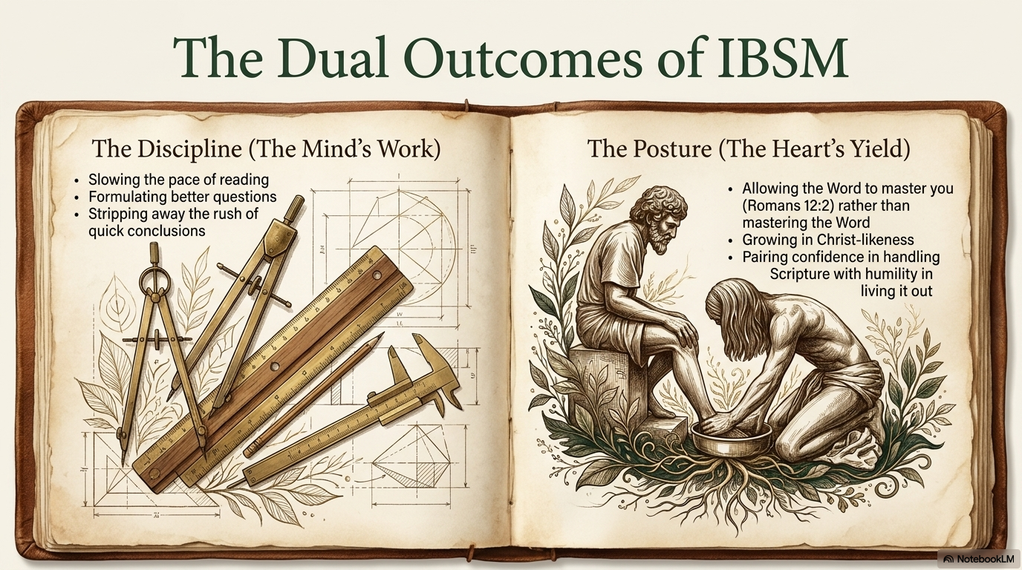

Slide 29
All Scripture is inspired by God and profitable for teaching, for reproof, for correction, for training in righteousness; that the man of God may be adequate, equipped for every good work.
2 Timothy 3:16-17

Slide 30


